Slide 1

Software Engineering
WS-2017-2018
23.Oct
30.Oct
From 15.00-18.00 h Room 8-103
06.Nov
13.Nov
20.Nov
27.Nov
04.Dec
11.Dec
18.Dec
08.Jan
15.Jan
22.Jan
29.Jan
05.Jan
12.Jan
19.Jan
26.Jan
https://www.yammer.com/uni-2017-2018

Slide 2
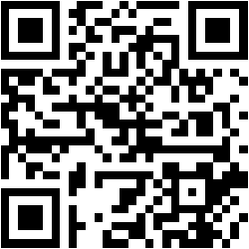

Building and running .NET Core applications
Damir Dobric
Microsoft Regional Director Microsoft Most Valuable Professional
Blog
Twitter
damir.dobric@daenet.com https://about.me/damirdobric

Slide 3
.NET Standard

Slide 4
What is .NET Standard?
The .NET Standard is an API spec that describes the consistent set of .NET APIs that developers can expect in each .NET implementation
https://github.com/dotnet/standard/blob/master/docs/versions.md

Slide 5
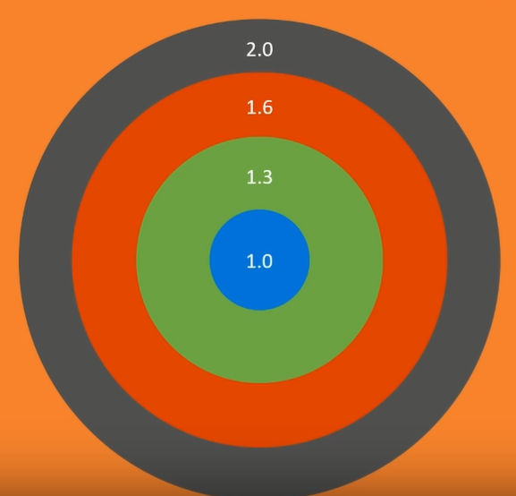
.NET Standard
PCL is common lowest denominator
Standard is replacement for PCL

Slide 6
Which standard should I support?
Number of APIs
Number of Applications
1.0
1.1
1.2
1.3
1.4
1.5
1.6
2.0

Slide 7
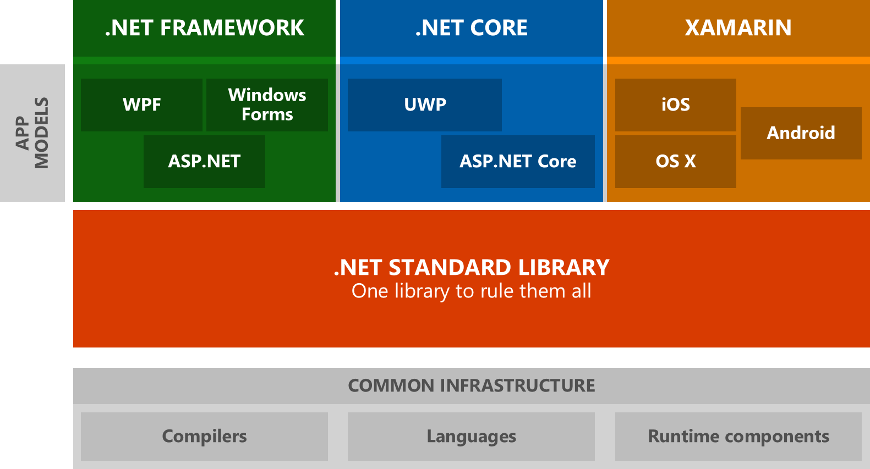

Slide 8
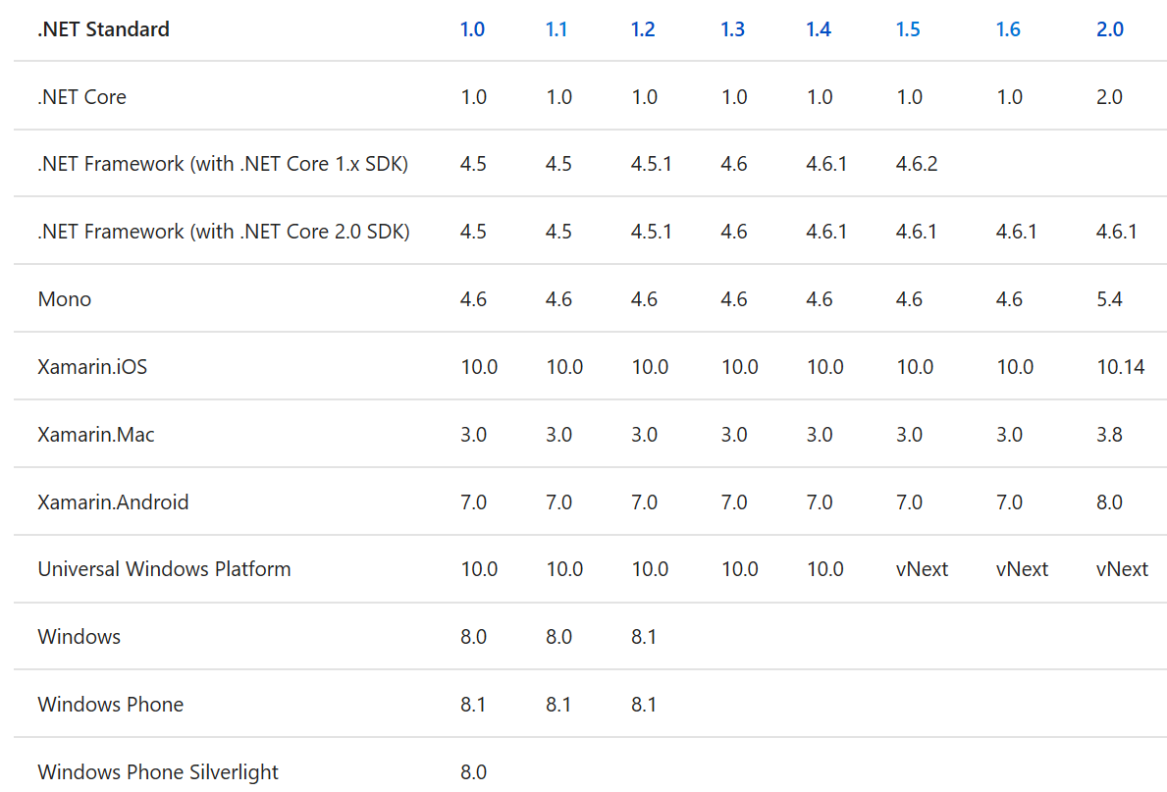
.NET Standard

Slide 9
API Browser
https://apisof.net

Slide 10
Frameworks and Runtimes
Target Frameworks
https://docs.microsoft.com/en-us/dotnet/standard/frameworks
Target Runtimes
Used to identify target platforms where the application runs https://docs.microsoft.com/en-us/dotnet/core/rid-catalog

Slide 11
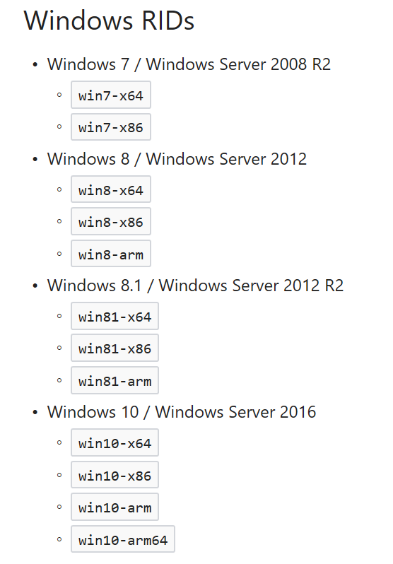

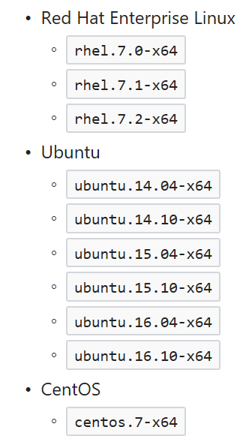
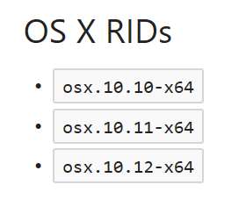
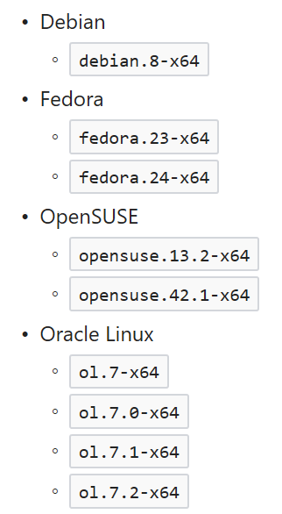
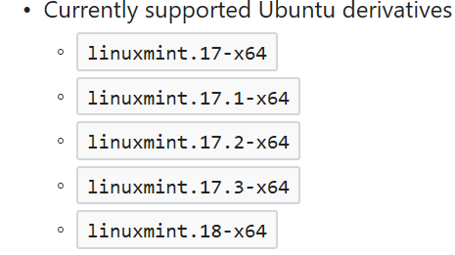
Currently Supported OS
https://docs.microsoft.com/en-us/dotnet/articles/core/rid-catalog

Slide 12
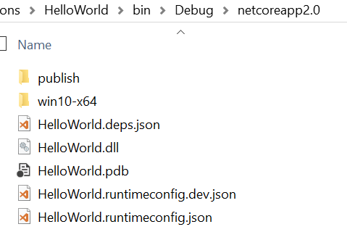
Build application
Build application:
C:\AppFolder>dotnet build
You application is still here ☺ in DLL
You can run it with: dotnet helloworld.dll

Slide 13
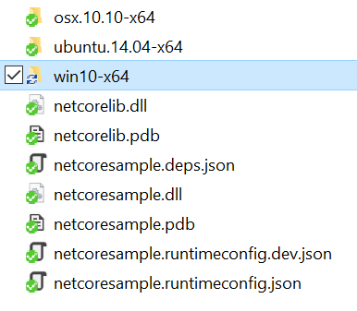
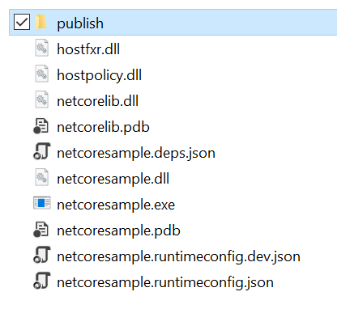
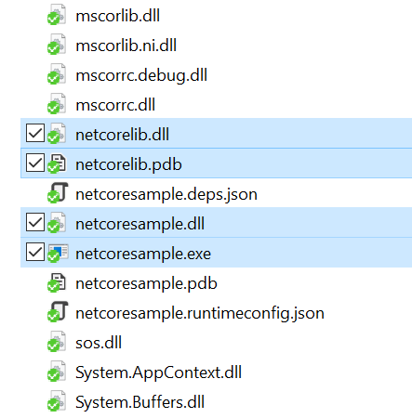
Build Self-Contained Application
Build application:
C:\AppFolder>dotnet build
Build application:
C:\AppFolder>dotnet publish –r win10-x64
C:\AppFolder>dotnet publish –r win10-x86
C:\AppFolder>dotnet publish –r ubuntu.14.04-x64
C:\AppFolder>dotnet publish –r ubuntu.14.04-x64
All framework assemblies are deployed with application.

Slide 14
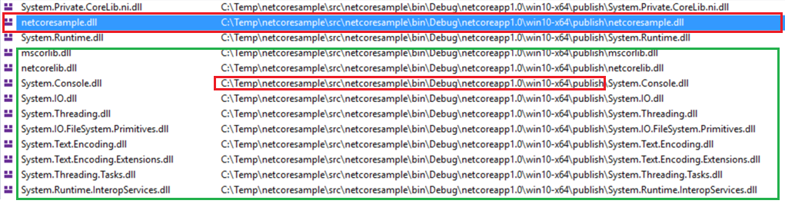
Run with dbl-click on .EXE
Application is still DLL
Framework is loaded from application path and not from installation.

Slide 15
Working with objects
public class MyClass {
public double SomeMethod(int a, int b) { return a / b;
}
}

Slide 16
Cross Referencing
netstandard 2.0 -> netstandard 1.1,..,1.6
net461 -> netstandard 2.0
error CS0012: The type 'Object' is defined in an assembly that is not referenced. You must add a reference to assembly 'netstandard, Version=2.0.0.0, Culture=neutral, PublicKeyToken=cc7b13ffcd2ddd51'.
Net452 -> netstandard 2.0
error : Project “NetCoreLib2.csproj' targets '.NETStandard,Version=v2.0’. It cannot be referenced by a project that targets '.NETFramework,Version=v4.5.2’.

Slide 17
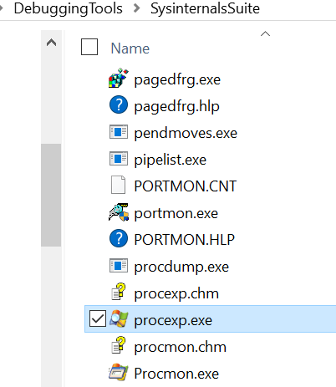
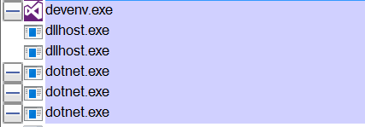
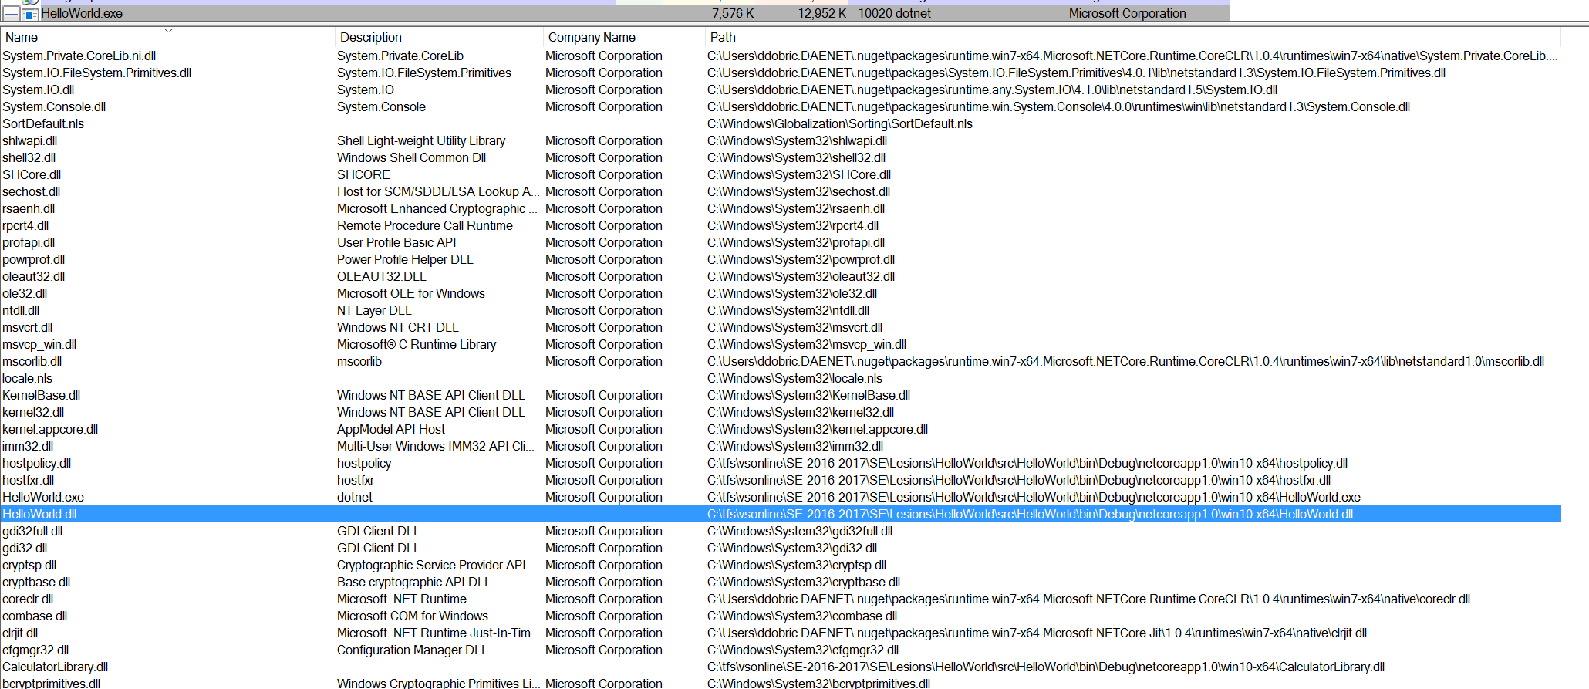
Process Explorer

Slide 18
Exercises
E6 - Framework Independent Build
E7 - Working with Debugger

Slide 19
(E5) Framework Independent Build
Open you HelloWorld application.
Change project file as follows
<RuntimeIdentifiers>
win10-x64;osx.10.11-x64;debian-x64
</RuntimeIdentifiers>
Open Command line in application root and execute ‘dotnet publish’:
>dotnet publish -r win10-x64
>dotnet publish -r osx.10.10-x64 –f netcoreapp2.0
>dotnet publish -r ubuntu.14.04-x64
… continued on next slide…

Slide 20
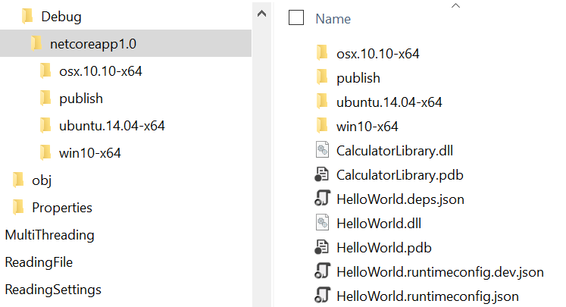

After publish…
Notice build for all runtimes (win, ox and linux)
Navigate to windows runtime folder.
… continued on next slide…

Slide 21
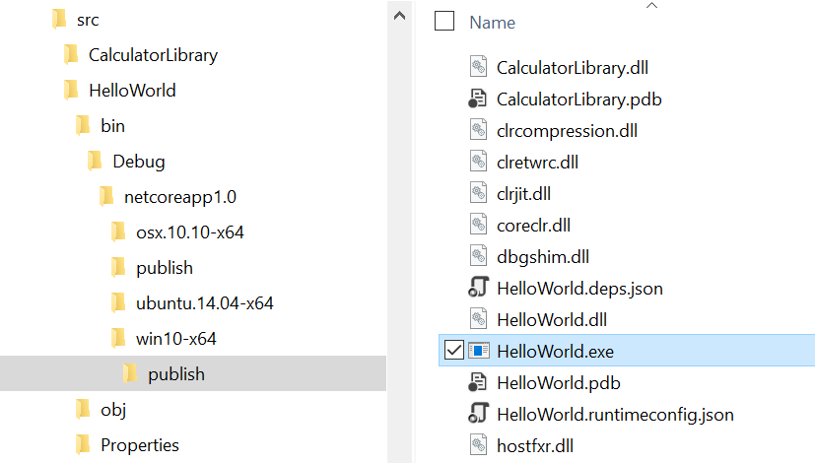
How and what to run?
Navigate to ‘win10-x64/publish’ folder.
Locate EXE and start it.

Slide 22
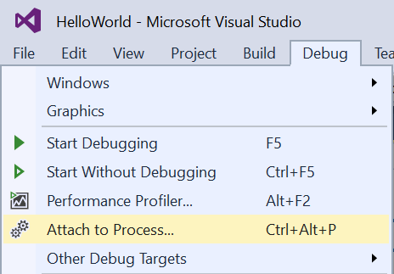
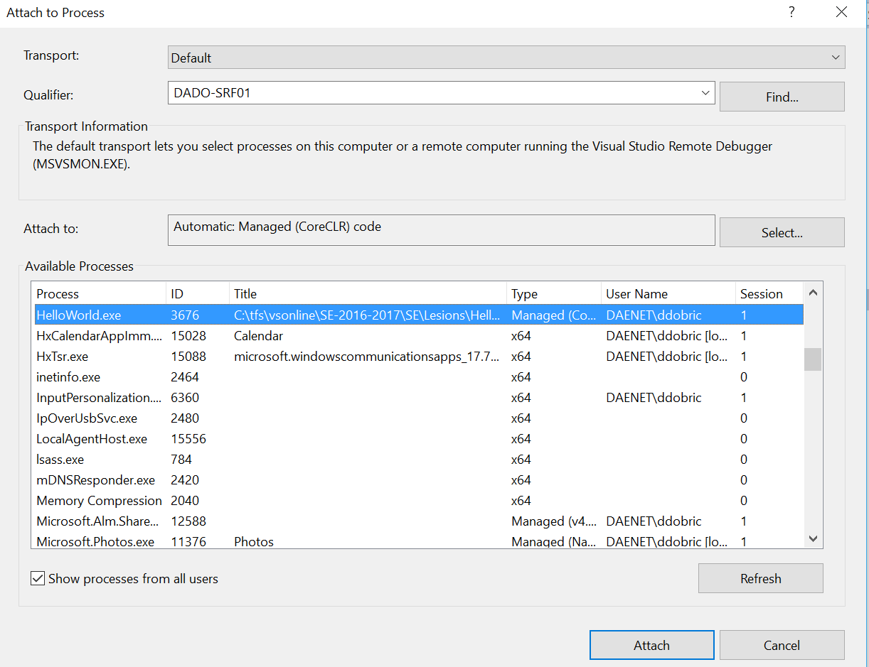
(E6) Working with Debugger

Slide 23
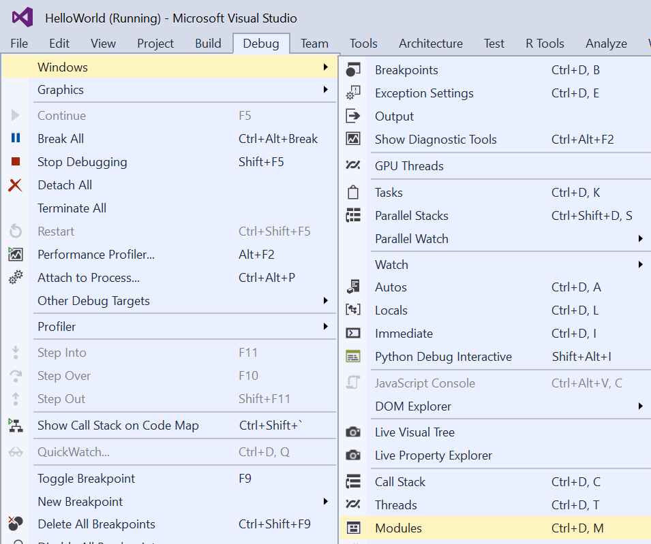
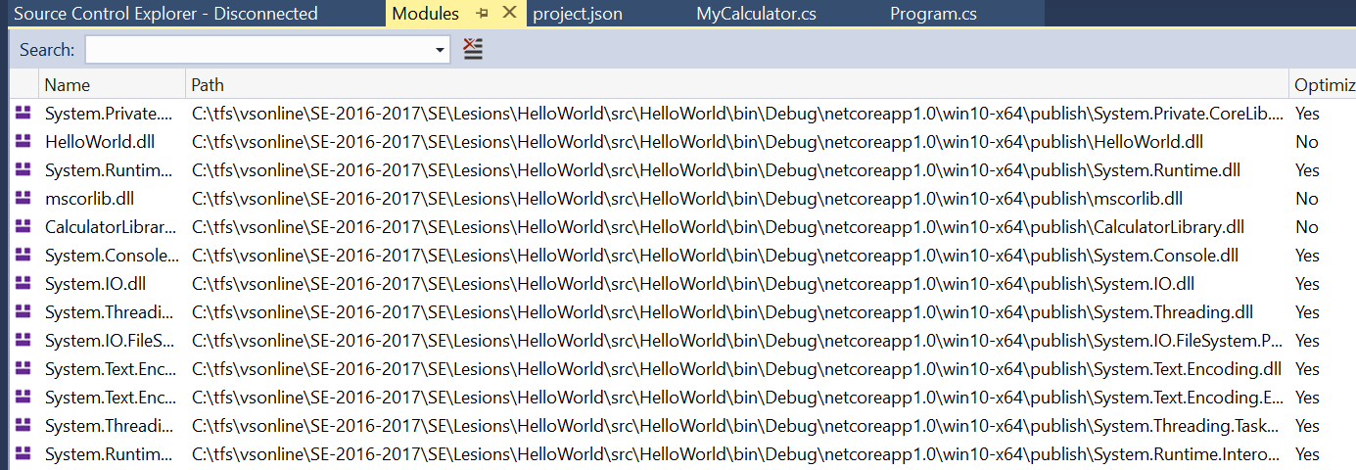
Explore loaded modules

